Slide 1
Display Item Information
Item Catalog
Item Inventory
February, 2018

Slide 2
Business Objectives
Being able to access item inventory records, inventory transactions, and usage data helps materials managers with planning and sourcing.
Departmental users who order stock items can gain time and efficiency by checking item availability, item requisition status, backorder status, existing authorized and unauthorized purchase orders for an item, and more.
Sites can assign items to multiple inventories so that specific items are grouped for the clinical areas that use them; for example, OR.

Slide 3
Learning Objectives for this Lesson
This lesson teaches you to:
Understand how to open and view item catalog data.
Access and understand key information in your site’s item record inventories.
Review and use menu-driven activities for item records; such as: viewing transactions.

Slide 4
Some Terms:
The item catalog (or, item file) is the master list of items commonly used and ordered at your site.
The item catalog contains file items:
Stock items - Items normally kept on hand in a storeroom; or, for a hospital that does not maintain stores, an item that is used and ordered continuously.
Non-stock items - Items used frequently, but not kept on hand. They are ordered as needed.
Items in the item catalog are assigned to one or more asset locations.
Non-file items, typically “special order,” are not listed in the item catalog.
An asset location contains the item data used for requisitioning, purchasing, receiving, invoicing, and accounts payable activities, regardless of whether the hospital keeps items on hand, or uses a stockless supply process. Medical centers typically have several asset locations. Departments are assigned a supplying asset location.
An item inventory is the list of items in an asset location.
The terms item inventory and asset location are mostly interchangeable.

Slide 5
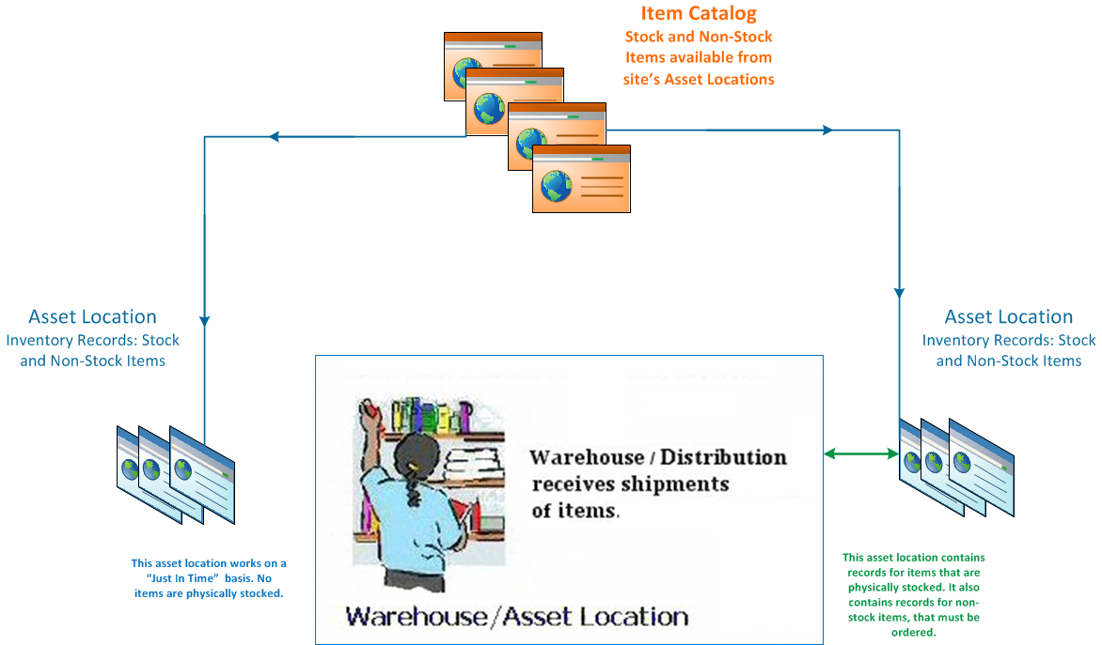
Where Are We in the Supply Chain?

Slide 6
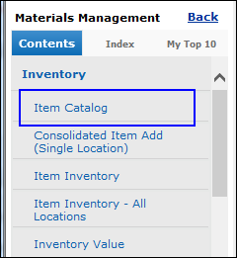
Display Item Information: Access the Item Catalog
The Item Catalog contains item records for all organizations.
To open the item catalog, from the Materials Management main Contents, select Inventory > Item Catalog.
Items are added to the item catalog by authorized users via Consolidated Item Add (in the menu).
Items in the catalog are assigned to one or more asset locations/inventories.

Slide 7
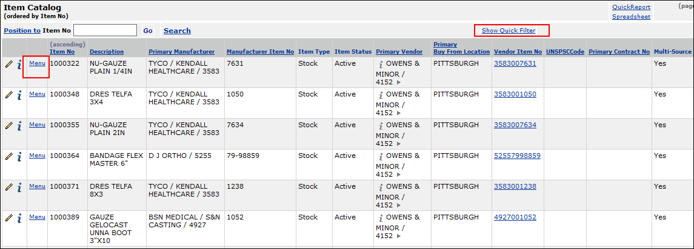
Display Item Information: The Item Catalog
Here is a sample of an item catalog page.
Click Show Quick Filter to open an input box at the top of each column. Entering characters in the box and pressing Enter searches the column.
Click the Menu for a list of activities.
The pencil icon opens an edit panel (if you have permission to edit items.)
i opens an inquiry on the item. Inquiry is always view only; no editing is possible.

Slide 8
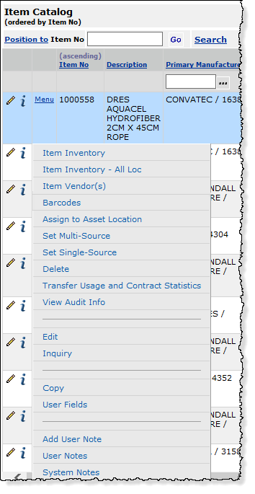
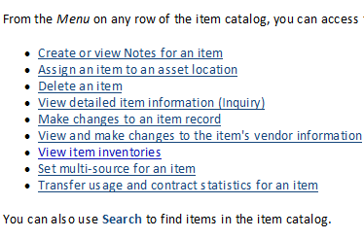
Display Item Information: The Item Catalog Menu
Activities on the item menu:

Slide 9
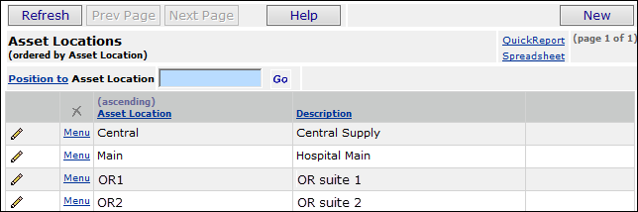
Display Item Information: About Asset Locations
Asset locations are set up in your system’s tables during implementation. You can see asset locations at your site from the Materials Management Tables.
Tables > Asset Location
The asset location assigned by default to your department is in your Current Settings. But, your User Profile may allow you to access data in other asset locations as well.

Slide 10
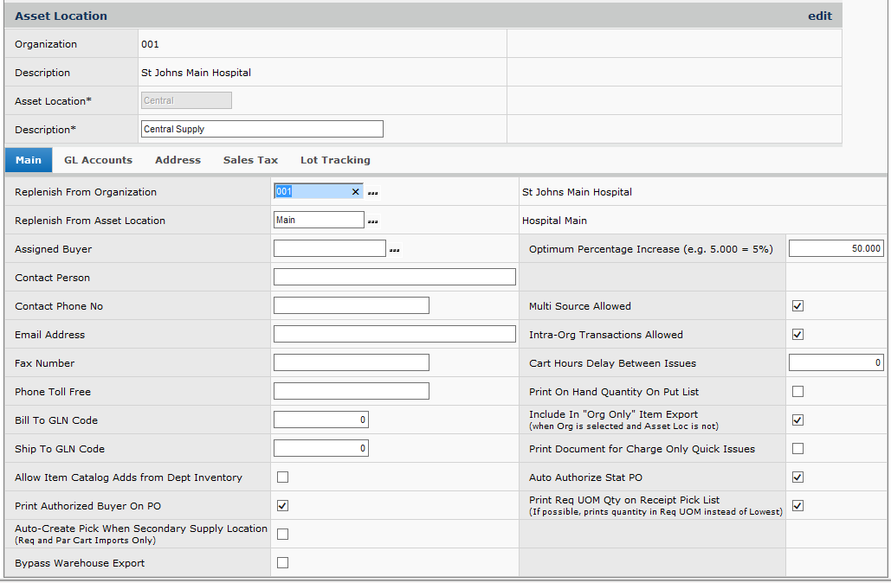
Display Item Information: Asset Location Records
Departments' requests for items (which may generate purchase orders) and the filling of requests take place through asset locations.
Par carts and order guides are set up by department and asset location.
Asset locations are defined in asset location records. Here is an example:

Slide 11
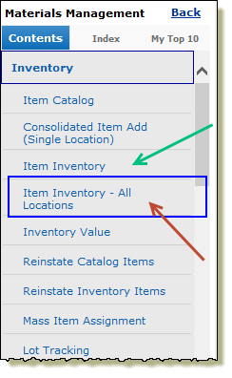
Display Item Information: Inventory Lists
Remember, we are using “inventory” and “asset location” interchangeably.
To display items in all your authorized asset locations select:
Materials Management main Contents >
Inventory > Item Inventory - All Locations. (red arrow).
To display items in the asset location
from your Current Settings only, select
Item Inventory (green arrow).
The Item Inventory List appears.
You may not be able to see items in all asset locations
at your site. The Data Profile assigned to your User ID specifies which asset
locations, departments, and organizations you can access.

Slide 12
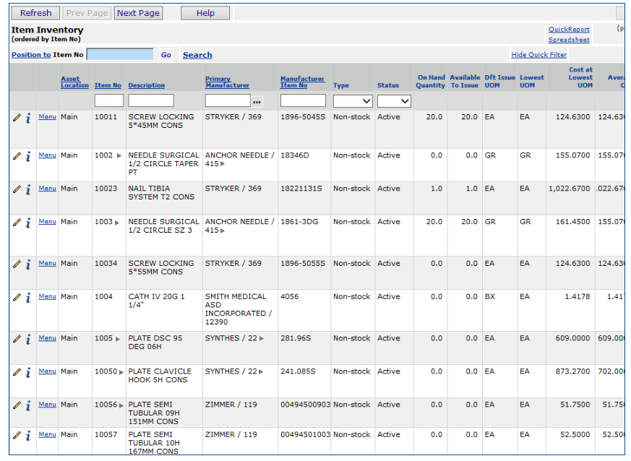
Display Item Information: Inventory List Tools
Here is part of the Item Inventory List for two different asset locations: Main and OR1.
Click the arrow next to an item number to display a picture, MSDS sheet, or contract number.
Clicking the arrow next to the manufacturer opens a web page.
Click the i (inquiry) to get item details.

Slide 13
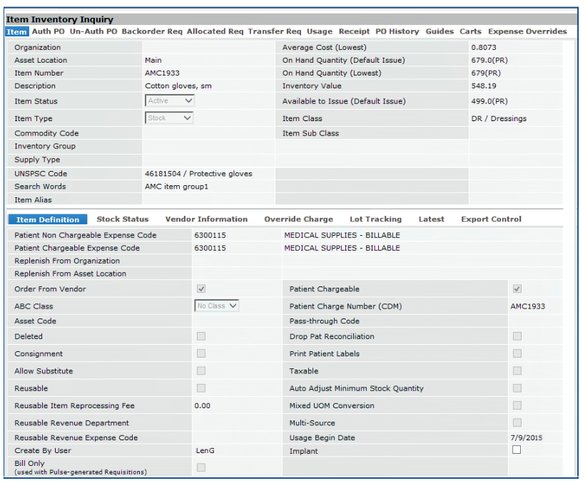
Display Item Information: Inventory Records
On the item Inquiry (i),
several tabbed panels provide different kinds of item information.

Slide 14
Display Item Information: Inventory Record Panel - Top Tabs
Item: Item and inventory information.
Auth PO: Currently authorized POs containing orders for the item.
Un-Auth PO: Currently unauthorized POs containing the item.
Backorder Req: Requisitions that have the item on backorder.
Allocated Req: Requisitions that have allocated the item.
Transfer Req: Requisitions that make up the Transfer In Qty from the Stock Status tab.
Usage: The total quantity of the item used during an accounting year, and the total cost for the item. You can also get a detailed breakdown by month from the Menu on this panel, and statistics by department and across organizations.
Receipt: Receipt summaries by year, and receipt details.
PO History: Purchase orders for the item over several years.
Guides: Order guides containing the item.
Carts: Par carts containing the item.
Expense Overrides: Expense codes for the Issued To organization that will override the existing default expense. This tab is only visible if a flag has been set in Administration > System Values.

Slide 15
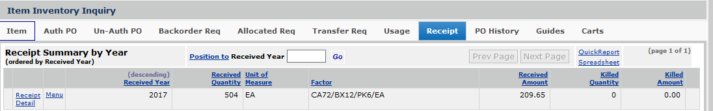
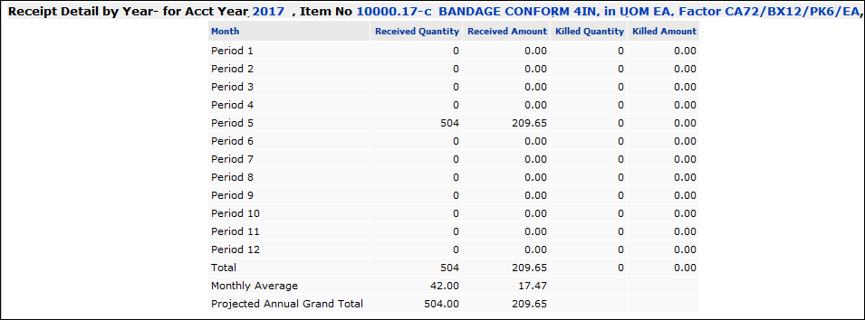
Display Item Information: Inventory Receipts Panel - Top
Here’s an example of the Receipts list for an item.
There is one receipt in 2017 for 504 each of the item.
Clicking Receipt Detail gets more information:

Slide 16
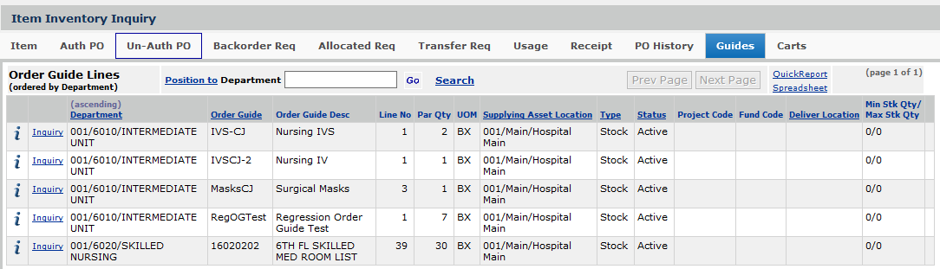
Display Item Information: Inventory Guides Panel - Top
Here’s an example of the Guides list for an item.
The list displays all the order guides that contain the item.

Slide 17
Display Item Information: Inventory Panel - Bottom Tabs
Item Definition: A subset of the categories from the item catalog that characterize the item and are relevant to inventory (e.g., Patient Chargeable and Non-Chargeable Expense Codes, ABC Class, whether the item is a consignment item, etc.)
Stock Status: Quantity descriptors and values (Minimum Stock Quantity, Maximum Stock Quantity, Allocated Quantity, On-Order Authorized Quantity, Pipeline Days), aisle/bin locations, physical inventory information, and more.
Vendor Information: The Primary Vendor and Primary Manufacturer, Contract number (if relevant), UOMs (lowest, order, issue) and conversion values for UOMs.
Override Charge: The department (and organization) to which the item is charged as a override of the usual charge department.
Lot Tracking: Lot tracking information, if used: Lot Number, Expiration Date, Serial Number.
Latest: Updated statistics such as Last Inventoried Date, Last Inventoried Quantity, Last Received Date, Last Invoice Date.
Export Control: Descriptors for codes used to select the item when exporting item data; for example, to a Pyxis unit.

Slide 18
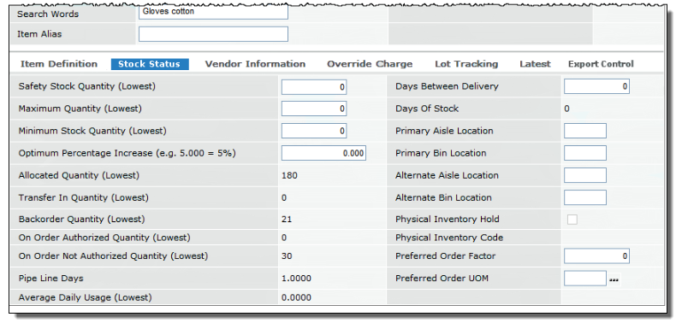
Display Item Information: Inventory Stock Status Panel
Here is an example of the Stock Status panel for some gloves.

Slide 19
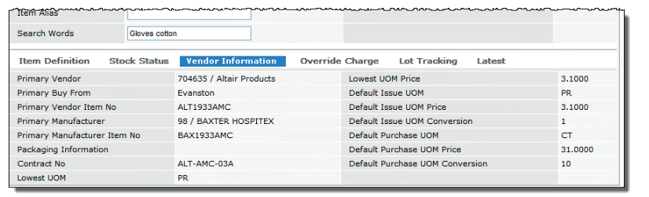
Display Item Information: Vendor Information Panel
Here is an example of the Vendor Information panel for the gloves.

Slide 20
Display Item Information: Access Inventory Transactions
For any item, click Menu > View Inventory Transactions

Slide 21
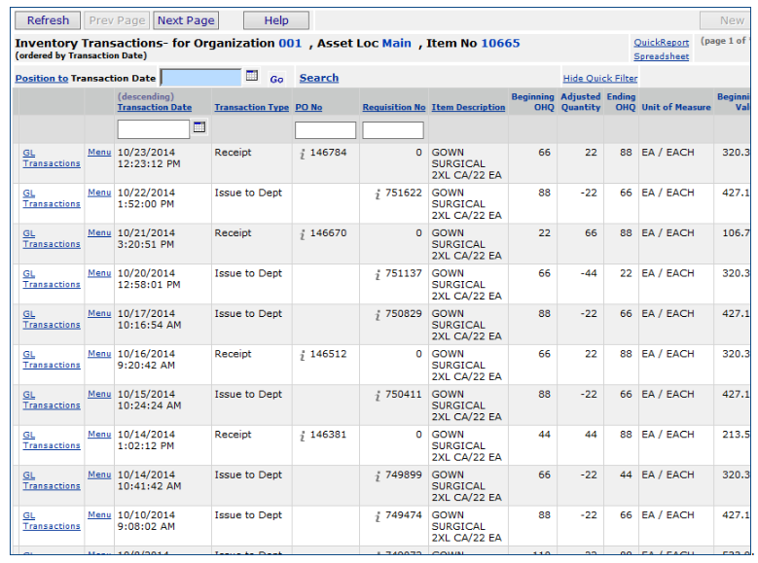
Display Item Information: Inventory Transactions List
For any inventory
transaction,
you can drill down
to the GL
transactions that
it generates.
Click
GL Transactions.

Slide 22
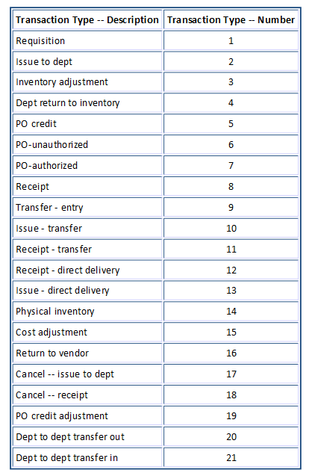
Display Item Information: Inventory Transaction Codes
Some report definitions use the Transaction Number, instead of the Transaction Description, for brevity.

Slide 23
Summary
The item catalog and item inventory features give you key information about stock and non-stock items used at your site.
The Inventory menu in Materials Management lets you access the item catalog and item inventory lists, and drill down to detailed information for any item. Information includes vendor, manufacturer, units of measure and their prices, charging information, stock status and availability, and more.
You can display inventory transactions for an item, edit item information (if you have authority), display purchase orders, requisitions, and receipts for an item, including backorders.
Where to get more information in the online documentation:
Search for “View/Edit Item Inventory Information” and “Work with the Item Catalog”.
Keep the quotes when you enter these topics in the search box.

